Slide 1
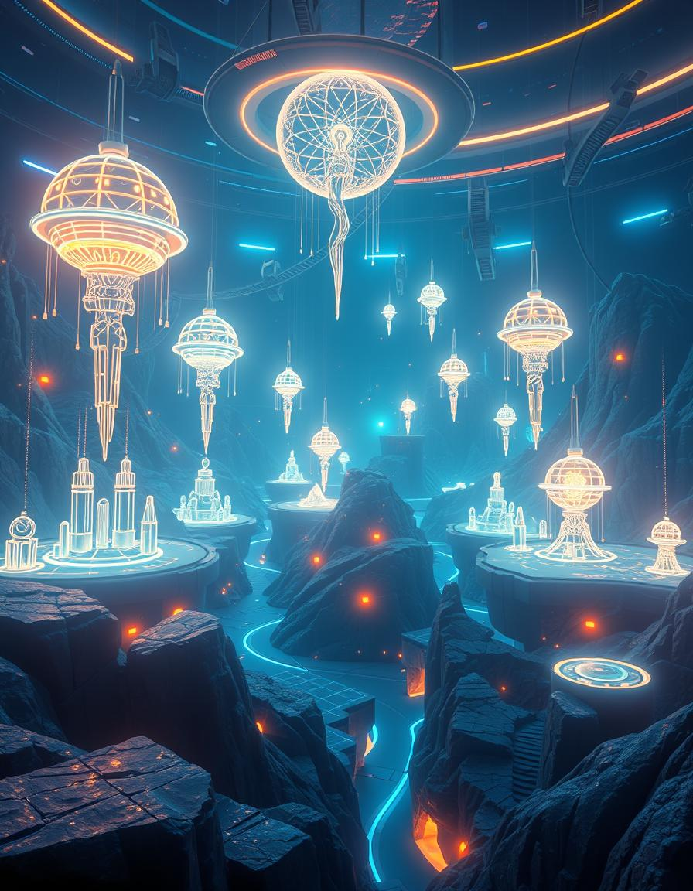
Group No. 9
Class: TY_AI-A Subject: AI
Presentation Topic
Generative AI in VR
Group Members
Sr.no | Roll.no | PRN | Name
1 | 70 | 12320204 | Diksha Teware
2 | 71 | 12320027 | Rutuja Diwate
3 | 72 | 12320102 | Ashwanti Gaikwad
4 | 73 | 12320138 | Hitesh Tolani
5 | 75 | 12320031 | Shravan Kalzunkar

Slide 2
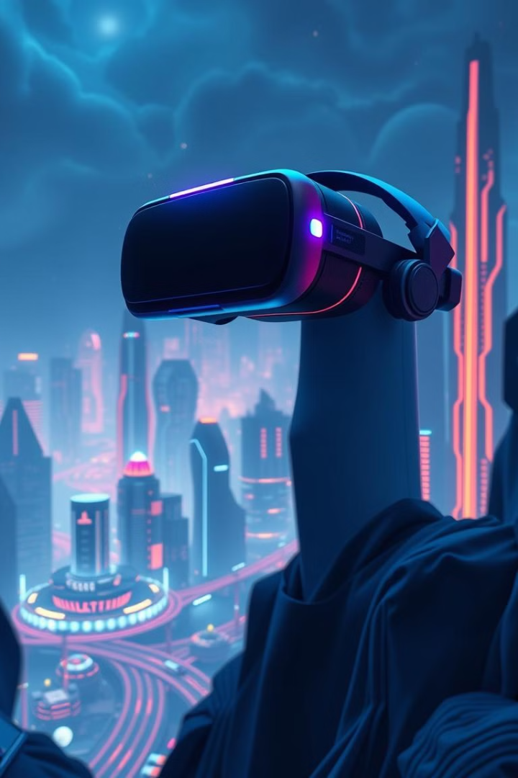
Introduction to Generative AI in Virtual Reality
Generative AI is a branch of artificial intelligence that creates new content, such as images, 3D models, and textures, by learning from existing data, using models like GANs and VAEs.
In Virtual Reality (VR), Generative AI enhances immersion by generating realistic environments, objects, and avatars in real-time, significantly reducing the need for manual content creation.
This technology enables the creation of dynamic, scalable, and personalized virtual worlds that adapt to user interactions, making VR experiences more engaging and interactive.

Slide 3
Litreature Survey
Sr.no | Paper Name | Author | Publication Year | Summary
1. | Art and the science of generative AI: A deeper dive | Ziv Epstein , Aaron Hertzmann | 2023 | The paper explores the transformative impact of generative AI on creative processes across various media, emphasizing its potential to reshape sectors like culture, economics, and law. It also discusses key themes such as aesthetics, ownership, creative work, and the media ecosystem, highlighting the need for interdisciplinary research to inform policy decisions.
2. | Understanding Virtual Reality Technology | Moses Okechukwu Onyesolu, Felista Udoka Eze | 2018 | The paper traces the evolution of Virtual Reality (VR) from the 1960s to the rise of accessible desktop VR, or non-immersive VR. It highlights how desktop VR, especially in the form of virtual learning environments (VLEs), has been widely adopted in education. These VLEs enhance learning by offering interactive, 3D experiences that improve student engagement.
3. | Revolutionizing Virtual Reality with Generative AI | Mohd Ekram Alhafis Hashim, Wan Azani Wan Mustafa | 2023 | This study examines 26 papers on generative AI in VR, highlighting its ability to enhance immersion, automate content creation, and improve user interaction. It shows potential for transforming industries like gaming, education, and healthcare by offering more interactive and immersive experiences.

Slide 4
Litreature Survey
Sr.no | Paper Name | Author | Publication Year | Summary
4. | Authoring 3D Layouts with Generative AI Models in VR | Lie Zhang,Jin Pan | 2024 | The study introduces VRCopilot, a system that combines generative AI with immersive authoring in VR for human-AI co-creation. It explores different creation methods and finds that scaffolded creation with wireframes improves user control, while manual creation provides the most creativity and agency.
5. | Advances in Neural Rendering | A. Tewari1, J. Thies | 2022 | The report explores advances in neural rendering, which combines traditional computer graphics with machine learning to synthesize photo-realistic images and videos from real-world data. It highlights methods that use learned 3D scene representations, enabling applications like novel viewpoint synthesis and scene editing. The paper also addresses approaches for both static and deformable scenes, and discusses open challenges and social implications of these technologies.

Slide 5
Generative Models in VR
Generative Adversarial Networks
Variational Autoencoders
Diffusion Models
VAEs excel at creating diverse, high-fidelity content like textures, materials, and object variations for VR worlds.
These models can generate unique, unconventional 3D forms that challenge the boundaries of traditional asset creation.
GANs can generate hyper-realistic 3D assets, from buildings to characters, that seamlessly integrate into VR environments.

Slide 6
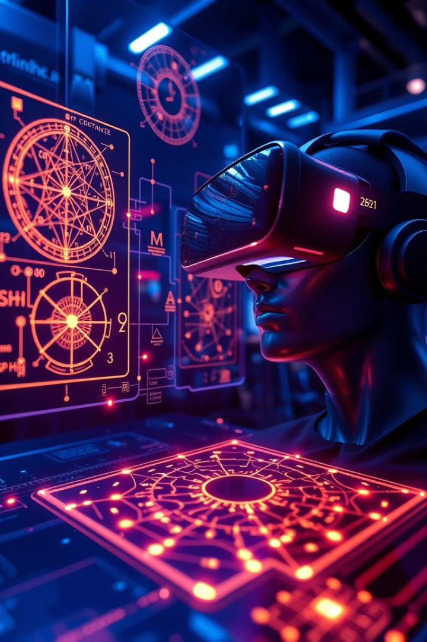
Current State of
Generative AI in VR
1
Real time content generation
AI models like GANs and VAEs generate dynamic environments and 3D objects in real-time.
2
Texture Synthesis
AI generates high-resolution textures from low-quality data, improving visual fidelity in VR environments.
3
AI generated avatars
AI creates customizable, lifelike avatars, improving user interaction in social VR platforms.

Slide 7

Neural Rendering in VR
1
Differentiable Rendering
2
Neural Textures
3
Implicit Representations
Learned texture representations can add unprecedented realism and detail to virtual objects and environments.
Enables the optimization of 3D assets for real-time rendering, seamlessly blending CG and real-world elements.
Novel neural network architectures can compactly represent 3D geometry, enabling fast, efficient rendering.

Slide 8
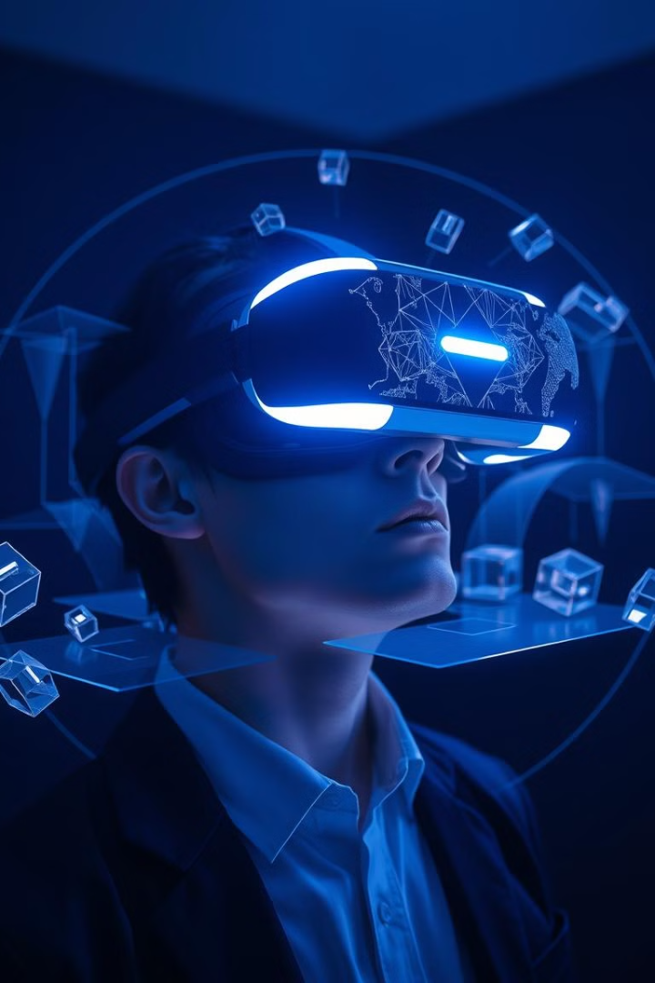
Real-time 3D Model Generation Techniques
1
Latent Space Exploration
Navigating the latent space of generative models to interactively create and customize 3D assets.
2
Conditional Generation
Generating 3D content based on user inputs, sketches, or other contextual information.
3
Procedural Synthesis
Leveraging algorithmic techniques to generate infinite variations of 3D models on the fly.

Slide 9
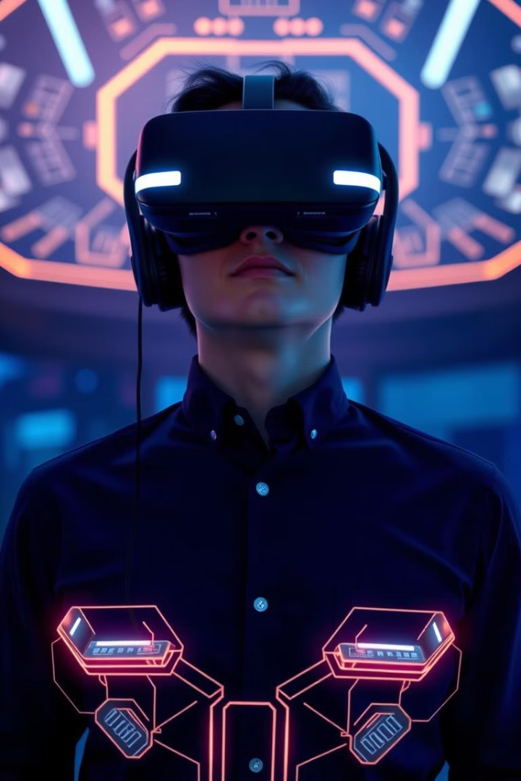
Generative AI for Motion Synthesis in VR
Animation Control
Emotional Expression
Generating seamless, responsive character animations that adapt to user interactions and environmental cues.
Creating lifelike facial expressions and body language to convey the emotions and personalities of virtual agents.
Physics-based Dynamics
Emergent Behaviors
Simulating realistic physical interactions and movements that obey the laws of the virtual world.
Enabling virtual characters to exhibit autonomous, unpredictable behaviors that enhance the sense of immersion.

Slide 10
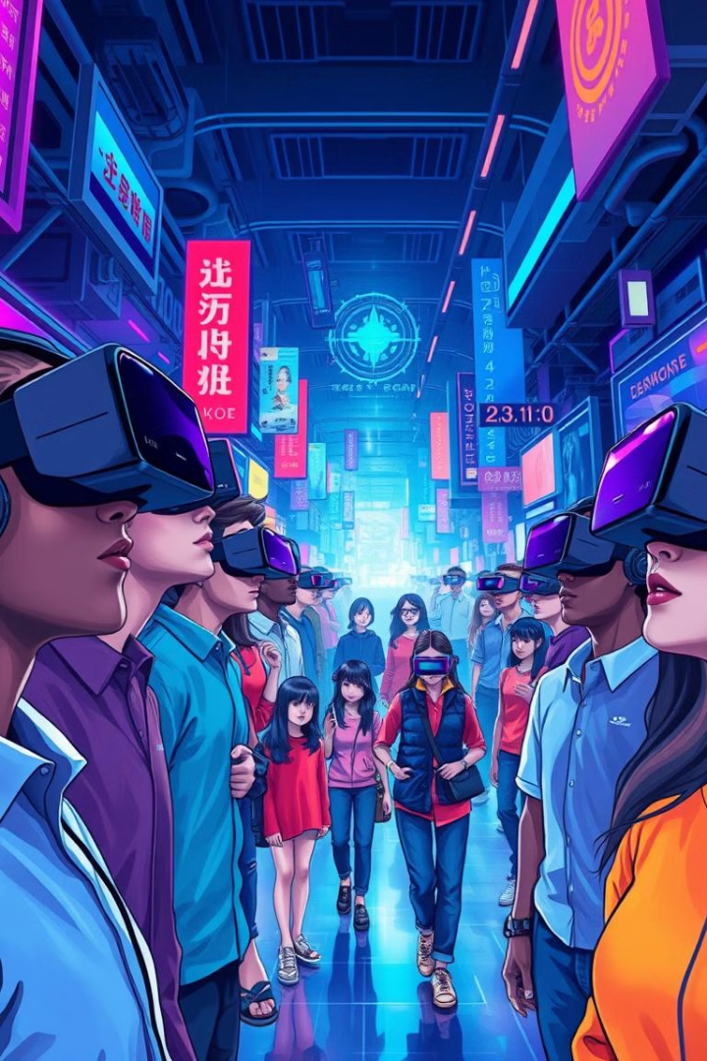



Reinforcement Learning for Dynamic VR Content
Adaptive Experiences
Reinforcement learning allows VR content to dynamically adjust to user preferences and behaviors.
Procedural Generation
RL-based techniques can create unique, unpredictable virtual environments that surprise and delight users.
Multiagent Coordination
RL can enable virtual characters to collaborate and interact in complex, lifelike ways.

Slide 11
Algorithms for Generative AI in VR
Generative Adversarial Networks (GANs)
Powerful for generating high-fidelity 3D models and textures
Variational Autoencoders (VAEs)
Effective at creating diverse, unconventional 3D content
Diffusion Models
Innovative for generating unique, complex 3D forms
Neural Radiance Fields (NeRFs)
Compact, efficient representations for real-time 3D rendering

Slide 12




Challenges in Applying Generative AI in VR
Real-time Performance
Ensuring low latency and high frame rates for seamless, responsive VR experiences.
Robustness and Reliability
Developing stable, predictable generative models that can handle the dynamic nature of VR.
Safety and Ethics
Addressing potential biases and negative impacts of generative AI in immersive virtual environments.

Slide 13
Applications of Generative AI in VR
Content Creation
Interactive Storytelling
Virtual Prototyping
Accelerating the development of 3D assets, animations, and environments for VR experiences.
Dynamically generating narrative elements, characters, and scenarios to create unique, personalized stories.
Enabling the rapid iteration and testing of product designs, architectural models, and other 3D concepts.

Slide 14
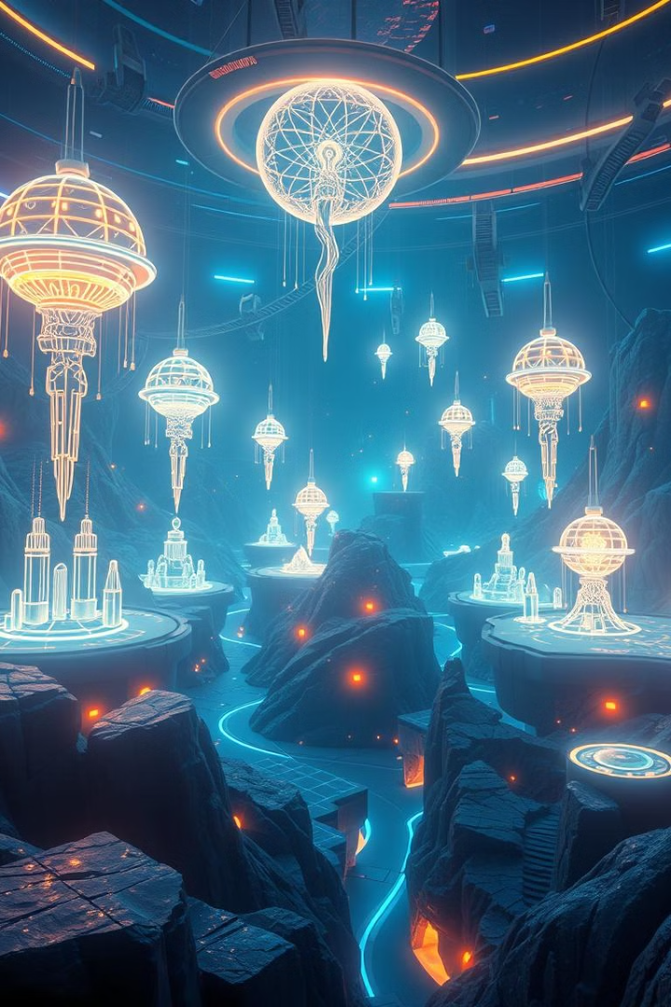
The Future of Generative AI in VR
In the future, Generative AI will enable autonomous scene creation in VR using advanced models like GANs and NeRFs, allowing real-time generation of complex 3D environments.
AI-driven dynamic content adaptation, powered by reinforcement learning, will adjust scenes and objects based on user interactions. Additionally, deep learning models like LSTMs will produce realistic avatar movements and facial expressions for lifelike interactions.
Cross-modal AI integration will combine visual, auditory, and haptic feedback, enhancing immersion and creating richer, multisensory VR experiences.

Slide 15
Thank You

